Slide 1
COMP9900 Computer Science/IT Capstone Project
Sprint 2 Demo

Slide 2
Title: Ontology-Enhanced PCA Models Using Eurofidai ESG Dataset
Group Name: 25T1 T12A Chocolate
Team Members:
Sujan Bharadwaj ( Product Owner and Back-End Developer )
Jordan Cubbin ( Scrum Master and Front-End Developer )
Vinanti Vinay Pathare ( Back-End Developer )
Vasanth Natarajan ( Back-End Developer )
Priya Shah ( Front-End Developer )

Slide 3
Project Overview

Slide 4
1)ESG Data Complexity & Challenges
2)Our Proposed Solution: Ontology-Enhanced PCA
Ontology for Consistency: We use an ontology to unify ESG metrics and harmonize definitions across industries.
PCA for Efficiency: Dimensionality reduction pinpoints the most influential ESG factors, improving interpretability.
Eurofidai ESG Dataset: Offers real-world, multi-industry metrics—ideal for validating our approach and testing robust solutions.
Inconsistent Reporting
High Dimensionality
Cross-Industry Comparability
Outliers & Missing Data

Slide 5
Overview of PCA
Principal Component Analysis (PCA):
A statistical technique for reducing the dimensionality of large datasets while retaining as much variance as possible.
Objective of PCA:
Semiconductor and Biopharma industries are analyzed using Baseline PCA and Ontology-Enhanced PCA to uncover key ESG factors and assess risk.
To reduce complexity by creating new variables (principal components) that capture the most significant patterns in the data.
To understand which ESG metrics drive the variance in the data.

Slide 6
Baseline PCA

Slide 7
Overview
Traditional PCA Approach
PCA applied directly to numerical ESG data.
Goal
Reduce dimensionality while retaining variance, focusing on identifying the top contributing ESG metrics.
Steps
Data standardization (Z-score).
Covariance matrix calculation.
Eigenvalue decomposition and selection of principal components.

Slide 8
Semiconductor Industry Overview
Objective
Identify key ESG metrics affecting semiconductor companies using Traditional PCA.
Data Processing
The data includes quantitative ESG metrics from semiconductor companies, standardized to remove biases due to differing scales.
Principal Components
Focus on capturing the dominant variance across ESG metrics.
Eigenvalue decomposition and selection of principal components.

Slide 9
Biopharma Industry Overview
Objective
Perform Traditional PCA on the Biopharma industry to understand ESG risk factors.
Data Processing
The data for Biopharma includes binary/qualitative data, such as ESG policies (e.g., "policy present: yes/no").
Principal Components
Capture variance in both qualitative and quantitative ESG metrics.

Slide 10
Data Preprocessing
Data Standardization
Ensures comparability across ESG metrics with different scales (e.g., emissions in tons vs. binary policy indicators).
Missing Data Handling
Drop companies with missing values or apply imputation techniques.
Objective
Normalize the data to allow fair comparison and reduce bias in PCA.

Slide 11
PCA Calculation
Covariance Matrix Computation
Captures relationships between variables.
Eigenvalues and Eigenvectors
Determine the principal components (PCs), where eigenvectors represent the directions of maximum variance and eigenvalues represent the magnitude of variance along those directions.
Component Selection
Based on explained variance, principal components are selected to retain as much information as possible.

Slide 12
Variance Explained
Each principal component captures a certain percentage of the total variance.
PC1: First principal component, captures the most variance.
PC2: Second principal component, orthogonal to PC1, captures the second-highest variance.
Additional PCs
Capture decreasing variance as we move forward.
Objective
To reduce data dimensionality without losing significant information.

Slide 13
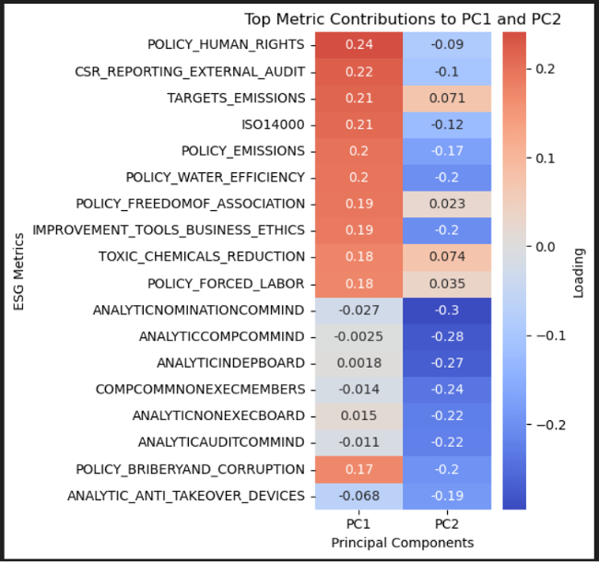
Top Contributing Metrics for PC1 and PC2
PC1 (First Principal Component):
Interpretation: PC1 reflects the major ESG factors related to environmental sustainability and human rights policies.
These metrics indicate that companies with strong human rights policies and emissions targets contribute significantly to the variance captured in PC1.
PC2 (Second Principal Component):
Interpretation: PC2 reflects the internal corporate governance structures, ethical policies, and board independence.
Semiconductor

Slide 14
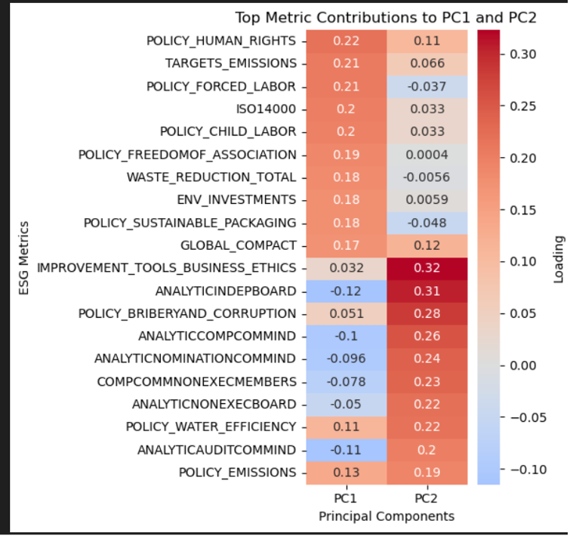
Top Contributing Metrics for PC1 and PC2
PC1:
Top Contributing Metrics: POLICY_HUMAN_RIGHTS, TARGETS_EMISSIONS, POLICY_FORCED_LABOR.
Interpretation: Captures the focus on human rights and environmental responsibility.
PC2:
Top Contributing Metrics: IMPROVEMENT_TOOLS_BUSINESS_ETHICS, ANALYTICINDEPBOARD, POLICY_BRIBERYAND_CORRUPTION.
Interpretation: Reflects governance and ethical metrics.
BioPharma

Slide 15
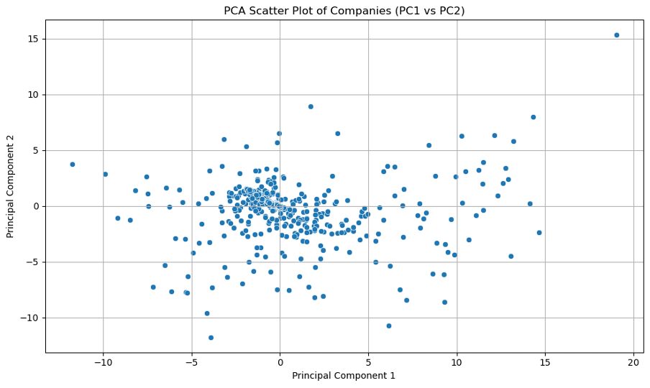
Baseline PCA - Scatter Plot
PC1 vs. PC2: The scatter plot visualizes the companies based on their scores along the first two principal components.
Most companies are concentrated near the origin, suggesting that most firms show similar ESG performance.
Some outliers are spread across PC1 reflecting companies that stand out in human rights policies or emissions control.
Semiconductor

Slide 16
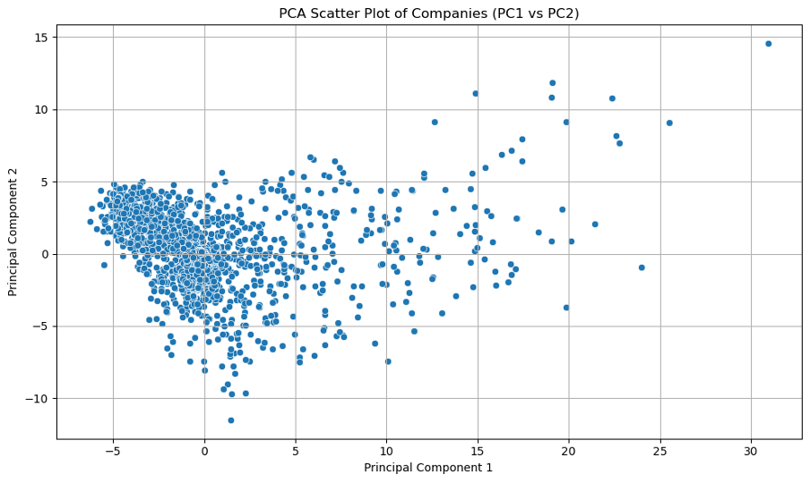
Baseline PCA - Scatter Plot
PC1 vs. PC2: The scatter plot visualizes the companies based on their scores along the first two principal components.
Companies differentiate by their governance and environmental metrics (e.g., human rights policies vs. board independence).
BioPharma

Slide 17
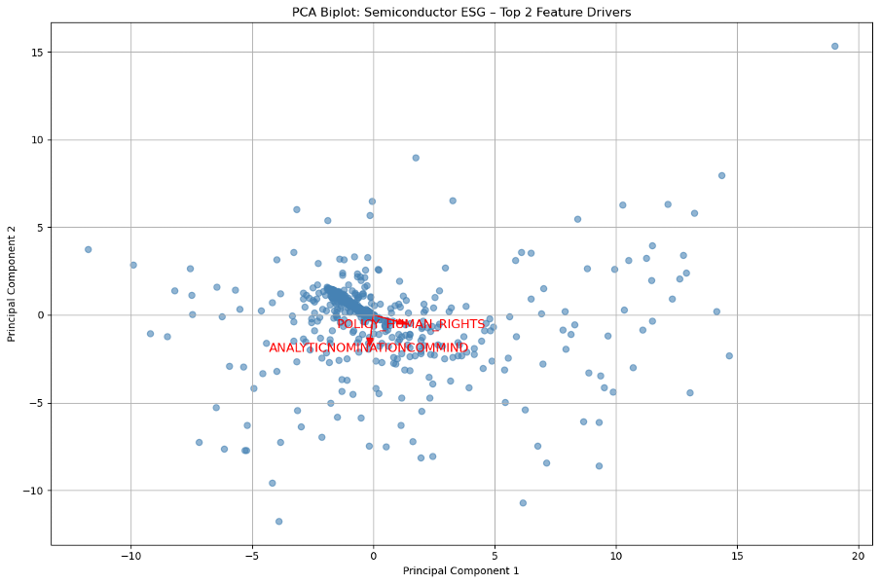
Baseline PCA - Industry Segmentation
Cluster Analysis:
Companies are divided into different clusters based on their ESG performance.
Cluster 1: Strong focus on emissions and waste management.
Cluster 2: Focus on energy efficiency and operational sustainability.
Cluster 3: Companies focusing on workforce safety and compliance.
Semiconductor

Slide 18
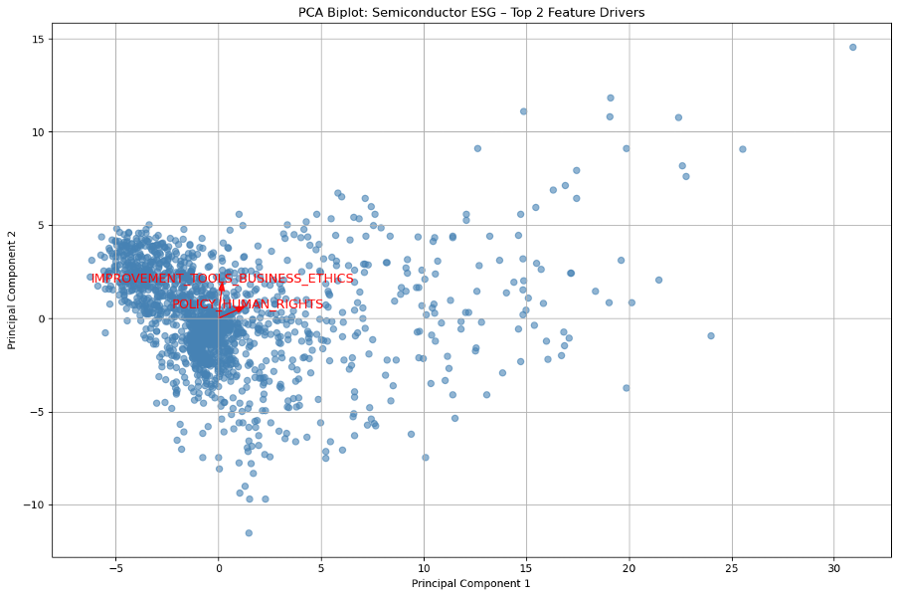
Baseline PCA - Industry Segmentation
Cluster Analysis
Cluster 1: Companies that focus more on human rights and emissions control.
Cluster 2: Companies with stronger governance structures, focusing on board independence and ethical practices.
Cluster 3: Companies with balanced performance across social and environmental factors.
BioPharma

Slide 19
Baseline PCA - Key Observations

Slide 20
Semiconductor Industry:
PC1: Driven by policy on human rights, emissions targets, and waste reduction.
PC2: Driven by corporate governance and ethics metrics, like board independence and business ethics.
PCA Results: Companies are clustered based on their ESG strengths and weaknesses, with some showing unique strengths in specific ESG areas.

Slide 21
Pharmaceutical Industry:
PC1 and PC2 dominate the variance, reflecting a sector with a strong emphasis on human rights, emissions targets, and corporate governance.
The low variability in the data suggests that most Biopharma companies have relatively consistent ESG profiles.
Companies with strong social responsibility (health and human rights) and strong governance (board independence) emerge as leaders in the PCA analysis.

Slide 22
What is Graph DB and Why We Use It
Graph DB is a semantic graph database that stores data as triples (Subject–Predicate–Object), making it ideal for managing ontology-driven knowledge.
Why Graph DB for ESG?
Ontology Integration: It allows us to model ESG metrics, categories, industries, and disclosure topics using a semantic hierarchy.
Flexible Queries: Using SPARQL, we can dynamically retrieve relevant ESG metrics for any industry or topic, e.g., all "GHG emissions" metrics for the "Semiconductors" industry.
Scalable Reasoning: Supports inference, helping uncover hidden relationships across ESG dimensions (e.g., risk vs opportunity).
Dynamic Model Activation: Based on user queries (like selecting a metric), GraphDB can trigger PCA models by linking ontology classes (e.g., GHG_Protocol_Model → Scope 1/2/3 metrics).
Explainability: Because relationships are explicit and traversable, GraphDB enhances transparency in ESG decision-making.

Slide 23
Ontology-Driven PCA

Slide 24
Overview
Ontology-Driven PCA Approach
Enhances PCA by integrating domain-specific ESG knowledge through an ontology.
Goal
To align PCA results with real-world ESG concerns by categorizing metrics into meaningful groups (Environmental, Social, Governance).
Ontology Integration
Provides semantic relationships between ESG metrics, improving interpretability.

Slide 25
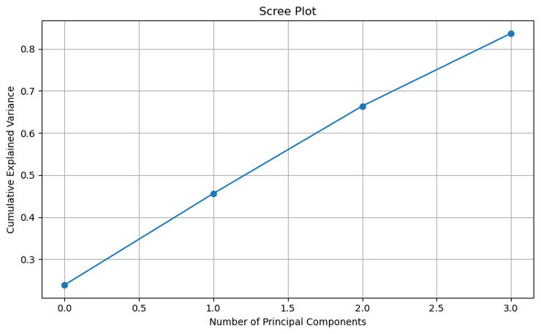
Semiconductor Industry Overview
Objective
Ontology-Enhanced PCA improves Traditional PCA by integrating domain-specific knowledge about ESG categories (Environmental, Social, Governance).
Key Insight
The first four principal components capture 83.7% of the variance, offering a multi-dimensional view of ESG performance.

Slide 26
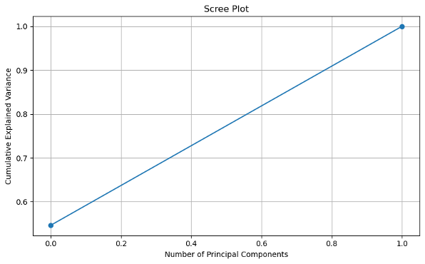
Biopharma Industry Overview
Objective
Apply Ontology-Enhanced PCA to the Biopharma sector to improve interpretability of the ESG factors.
Variance Breakdown:
PC1: 54.6%
PC2: 45.4%
These two components explain all the variance in the dataset.

Slide 27
Data Preprocessing
Mapping ESG Metrics to Ontology
ESG metrics are categorized into Environmental, Social, and Governance(ESG) categories based on the ontology framework.
Ontology Querying (SPARQL)
Retrieve structured ESG relationships to enrich the data.
Feature Selection
Group and select relevant features based on their semantic relationships to preserve the real-world meaning during PCA.

Slide 28
Enhanced Feature Selection
Using Ontology for Feature Selection:
Grouped Metrics: Related metrics (e.g., emissions, waste management) are grouped together to maintain their semantic integrity.
Ontology-Enriched Data: Helps prioritize metrics that are truly relevant to ESG risk assessments.
Outcome: The ontology ensures that the selected features in PCA align with industry standards and ESG priorities.

Slide 29
PCA Calculation with Ontology Enhancements
PCA Steps:
The same PCA process is followed (covariance matrix computation, eigenvalue decomposition).
Ontology-Enhanced Interpretation: The resulting principal components are analyzed in the context of ESG categories, ensuring that the features contributing to each component are meaningful.
Outcome
More interpretable and actionable insights into ESG data.

Slide 30
Variance Explained
In Ontology-Driven PCA, the variance is distributed across multiple components to reflect real-world ESG complexities.
PC1: Captures environmental sustainability metrics (e.g., GHG emissions and waste management).
PC2: Captures energy efficiency and health safety.
PC3: Highlights workforce safety and water management.
PC4: Focuses on the cross-cutting impact of environmental factors, especially GHG emissions and water management.
Outcome: More balanced and nuanced representation of ESG metrics.

Slide 31
Metric-Level Interpretation
Semiconductor :
PC1: Driven by Waste Management and GHG Emissions.
PC2: Driven by Energy Management and Health Safety.
PC3: Focused on Health Safety and Water Management.
PC4: Focused on GHG Emissions and Water Management.
BioPharma :
PC1: Dominated by Health Safety and Human Capital Development metrics.
PC2: Focuses on Business Ethics and Board Independence.

Slide 32
Ontology-Driven PCA - Key Observations

Slide 33
Semiconductor Industry:
PC1: Emphasizes waste management and GHG emissions (environmental sustainability).
PC2: Highlights energy management and health safety (operational responsibility).
PC3: Focuses on workplace safety and water management (social responsibility).
PC4: Focuses on GHG emissions and water management, showing multi-dimensional complexity.
Outcome: No single dominant component, allowing a multi-dimensional view of ESG factors.

Slide 34
Ontology-Driven PCA - Actionable Insights
Better Interpretability: Results are aligned with ESG categories, making them more relevant to stakeholders.
Enhanced Decision Making: ESG decision-making is improved with clearer insights into which ESG factors (e.g., emissions, workforce safety) drive risk and opportunity.
Visualization: PCA Biplot and Clustering Analysis showing company groupings based on ESG performance and strategy.

Slide 35
Baseline PCA vs. Ontology-Driven PCA
Traditional PCA:
Focuses purely on statistical variance.
Identifies dominant features based on raw data.
Ontology-Driven PCA:
Integrates semantic ESG knowledge to improve interpretability.
Aligns results with real-world ESG concerns (Environmental, Social, Governance).
Outcome: Ontology-driven PCA offers more actionable insights, making the results more relevant for ESG risk analysis.

Slide 36
Website Demo

Slide 37
Overview of Sprint 3

Slide 38
Planned Approach & Steps: (to change)
Feature Selection & PCA
Apply PCA on normalized ESG metrics to derive key risk/opportunity factors.
Compare baseline PCA vs. ontology-enhanced PCA, ensuring ESG relevance.
Check explained variance to pick optimal principal components.
Knowledge Graph (KG) Integration
Incorporate ontology-based KGs for industry-specific ESG relationships.
Align PCA outputs with domain knowledge to improve feature interpretability.

Slide 39
Thank You!

